Slide 1


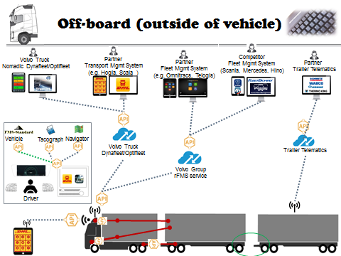
PVT Step 2
PVT Global Team through Tim Jansson, Arto Mattila and Jessica Erlandsson
February 2016

Slide 2

Agenda
Background
Current status
What is needed
Possibility examples
Conclusion

Slide 3
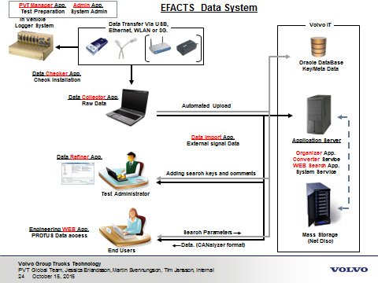
eFACTS Background
Designed and created from a blank paper without requirements
Started work after FDCG had passed in P2540 = a lot of pressure to deliver fast
Developed from start 2009 to be used at one site with a small number of users working with few vehicles from one brand
Status 2012: 2 sites, 130 users, 2 brands, 3 languages
Current status: 6 sites, 76 users, 19 product classes incl buses and VCE, >200 000 logfiles have been taken, approx 20% have been linked to >27600 Protus reports
New functionality have been frequently added as well as the global complexity
The current tools can be used as a good reference, new foundation is critical

Slide 4
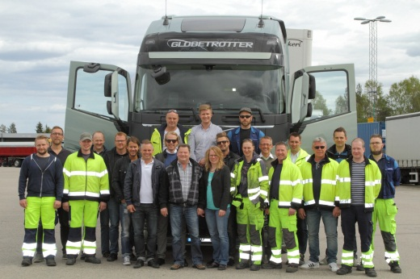
PVT, Performance Validation Test
Structured test method for Truck Functions
Efficient tool for test and data management
Agile team with driver perspective
PVT movie on Violin

Slide 5

Current status
Tools are not reliable and stops to work quite frequently, users have started to work outside tools
Continuous improvements and new ways of working not supported
PVT test methods hard to add. PVT Development, PVT Distribution and PVT Road Approval needs to be added, more coming
New setup of test cases is needed mainly due to global diversity, efficiency and maturity. Projects are unique and the product technical content keeps changing rapidly.
Inefficient work flow
Require a lot of manual work
Many hours can be spent to correct a single mistake by a user done during the manual work.
Tools are hard to understand (developed for approx 10 users)
Managing test cases require more than one resource 100%

Slide 6
Test case and method input
PVT Test Current workflow
”Best Scenario”
Project meetings
Functional Requirements
Existing Test cases
Develop New & Unverified Test Cases and Test methods
M-Logger Installation
Existing Test Code Extraction (xls)
Separate test code for unverified test cases
Video Extender installation
Need new meeting including Tim Jansson who has done the analysis to discuss the workflow
Test Code Execution (testing)
Trigger logfile
ISSUE FOUND!
NOK in Test Code
Extract logfile
Connect PROTUS to test case
Extract video files
Engineering Report
Upload logfile in Collector
Compile Test Result
Italian flag
Listen to logfiles in Refiner
Analyze logfiles and videos
Add to PROTUS list
Next test loop
Create PROTUS
Distribute Report
PROTUS Investigation
PROTUS Solved
PROTUS Verification Meetings
PROTUS Verification List Extraction
PROTUS Verification
Add values in Refiner and connect logfile to PROTUS
Add videos to PROTUS

Slide 7
Fault reporting, current workflow
Best Scenario*: Working on one fault report with Friday tools
Need new meeting including Tim Jansson who has done the analysis to discuss the workflow
1. Extract logfile
Grey boxes are not included!
2. Extract video files
1 to 3. Extracting and uploading logfiles
3. Upload logfile in Collector
15 min
4. Listen to logfiles in Refiner
36 min
4 to 8. Working with logfiles
5. Analyze logfiles and videos
21min
6. Create PROTUS
9. Distribute Report
Best scenario frequency Around 15% of the fault reports in P2967
7. Add values in Refiner and connect logfile to PROTUS
8. Add videos to PROTUS
*Best scenario: When the test leader does not need to work with the logfiles after reporting . Requires flawless logfile, flawless report and easy-to-verify-issue”
TIME SPENT ON WORKING ONE FAULT REPORT: 36 min

Slide 8
Test case and method input
PVT Test, Current workflow ”Normal Failure Scenario”
1.1. Project meetings
1.2. Functional Requirements
1.3. Existing Test cases
2. Develop new & unverified test cases and test methods
Red boxes = Tool inefficiency
Normal failure scenario frequency in P2967 Around 10% of the fault reports
3.1.M-Logger Installation
3.2.Existing Test Code Extraction (xls)
3.3 Separate test code for unverified test cases
3.4. Video Extender installation
4. Test Code Execution (testing)
11.2. Engineering Report
5.1 Trigger logfile
ISSUE FOUND!
5.2 NOK in Test Code
10. Connect PROTUS to test case
11.1. Compile Test Result
6.1 Extract logfile
11.3. Italian flag
8.7. Distribute Report
8.8. PROTUS Investigation
6.2 Extraction Failed
8.6. Add videos to PROTUS
8.9. PROTUS Incomplete
Need new meeting including Tim Jansson who has done the analysis to discuss the workflow
7.1 Upload logfile in Collector
8.5. Add values in Refiner and connect logfile to PROTUS
8.10. Investigation started
7.2 Logfile upload failed
8.4. Create PROTUS
8.11. Information added in PROTUS
9. Add to PROTUS list
7.3 MEA correction
Next test loop
8.3. Analyze logfiles and videos
PROTUS Investigation
PROTUS Solved
15.1. PROTUS Verification Meetings
15.2. PROTUS Verification List Extraction
15.3. PROTUS Verification
8.1. Refiner stopped responding when loading MEA
8.2. ”Assist me” to send logfiles
PROTUS handling

Slide 9
Fault reporting, current workflow
Normal failure scenario*: Working on one fault report with Friday tools
Need new meeting including Tim Jansson who has done the analysis to discuss the workflow
Grey & blue boxes are not included!
1.1. Extract logfile
3.7. Distribute Report
4.1. PROTUS Investigation
1.1. to 2.3. Extracting and uploading logfiles
3h 15 min
1.2. Extraction Failed
3.6. Add videos to PROTUS
4.2. PROTUS Incomplete
2.1. Upload logfile in Collector
3.1 to 3.7. Working with logfiles
3.5. Add values in Refiner and connect logfile to PROTUS
4.3. Investigation started
55 min
7h 40 min
2.2. Logfile upload failed
3.4. Create PROTUS
4.4. Information added in PROTUS
2.3. MEA correction
4.1. to 4.4. Working with incomplete report
3.3. Analyze logfiles and videos
5. PROTUS Investigation
3h 30 min
3.1. Refiner stopped responding when loading MEA
3.2. ”Assist me” to send logfiles
TIME SPENT ON WORKING WITH ONE FAULT REPORT: 7h40min
*Normal Failure Scenario: A highly recurring scenario when the test leader needs to work more with the logfiles after the fault report has been created. The logfile extraction/uploading also needed modification and support

Slide 10
Fault reporting, expected workflow
Best scenario with ideal tool: Working on one fault report with Monday tool
Need new meeting including Tim Jansson who has done the analysis to discuss the workflow
1. Tool support for automatic, reliable, fast and wireless transfer and upload of logfiles
1. Extracting and uploading logfiles
Blue boxes are not included!
0 min
2. Tool support for working with logfiles easily in Refiner
6. Distribute PROTUS
2 to 5. Working with logfiles
5 min
5 min
3. Tool support for using several videos files in refiner
5. Tool support for automatic connect information and values from Refiner to PROTUS
Working with incomplete report
0 min
4. Create PROTUS
TIME SPENT ON WORKING WITH ONE FAULT REPORT: 5 min!
*Best scenario with ideal tool: Several steps are automated and does not longer require time. The tool works without delays and waiting time.

Slide 11
Fault Reporting Tool Efficiency in numbers
One PVT test engineer created 900 fault reports last year
10% of the reports were ”Normal Failure Scenario reports” (7h 40 min)
15% of the of the reports were ”Best Scenario reports” (36 min)
75% of the reports were ”Normal reports” (1h)
The approximated average time spend on each report was 96 minutes.
1440 hours were spent on fault reports from the logfile was taken until the reports were complete with sufficient information. Testing, solving and solution verification were not included in this. And of course, the test leader was assisted by test drivers and co-workers in several of the steps.
The test leader believed that an efficient tool with ideal functional support, traceability and transparency could:
Reduce the amount of ”Normal Failure Scenario reports” to 2% (-8%)
Reduce the average time spent on”Normal Failure Scenario reports” to 4 hours (-3h 40min)
Increase the amount of ”Best Scenario reports” to 75% (+60%)
Reduce the average time spent on”Best Scenario reports” to 5 minutes (-31 min)
Reduce the amount of ”Normal reports” to 23% (-52%)
Reduce the average time spent on ”Normal reports” to 25 minutes (-35 min)
Reduce the average time spent on each report to 14 minutes (-82 minutes)
Reduce the time spent on creating 900 fault reports to 215 hours (-1225 hours yearly)
An efficient tool could reduce the time spent on fault reporting with 85%!
Need new meeting including Tim Jansson who has done the analysis to discuss the potential numbers

Slide 12

What is needed
The system shall support flexibility, efficiency and shall be easy to adapt to global diversity, rapid technology growth in products and unique project demands
Test cases are frequently edited, added and deleted at all six sites, new setup needed to keep global test value (Q, D, C, F)
The tools need to support new test methods and test execution. More efficient work flow and quality of information to describe symptons in products to developers and suppliers
The tools need to offer stability, performance, traceability, chain of activities and connections to other tools used within GTT during the development process
Known changes: New functional structure, Protus (Jira?), Protom, Ghost, Collaboration platform, ITS, ISO 26262, Data Protection Law

Slide 13











PROTUS
FAULT REPORT
TEST LEADER
VIEW, SORT, USE
STATISTICS, HISTORY
TEST MANAGER
LOG DATA
TEST DATABASE
CENTRAL SERVER
REFINER
DRIVER INTERFACE
LOCAL SERVER / HDD
LOG DATA

Slide 14








PVT DRIVER INTERFACE FH-1824 Total w1623 IB Tester Arto Mattila
MESSAGES
TEST STATUS
Don’t remove driver card or change it to rest, tachograph test running over time. Check ongoing test cases.
KALLE ANKA| 2016-08-23 14:23
ROUTINE | START OF TEST
SEQUENCE | CHECK
I activated the engine heater with a timer, check that it starts by 07:00
THE HOOK | 2016-08-23 14:23
ROUTINE | READ OUT FAULTCODES
SEQUENCE | BASE
Could you please take a picture of that problem you found yesterday.
TESTLEADER| 2016-08-23 12:00
SEQUENCE | BASE LOOP 2 | [20%]
ROUTINE | READ OUT FAULTCODES
STATS
ROUTINE | MINI EXPEDITION
OK 230
NOK 22
REM 300
SEQUENCE | TOTAL
ROUTINE | END OF TEST
44% DONE
OVERVIEW
TEST CODE
AUTO MODE
FAULT REPORT
SETTINGS
CAMERA
CHECK IN

Slide 15






PVT DRIVER INTERFACE FH-1824 Total w1623 IB Tester Arto Mattila
SORT BY TAGS:
STANDSTILL
RUNNING
ADD
POWERTRAIN / IDLE ADJUST / ADJUST IDLE SPEED
SELECT ON LOCATION
VERSION: 023_1.0
DESCRIPTION
Depress brake pedal, and keep brake pedal depressed. Hold resume button for two seconds.
WAIT 10 MINUTES
VIEW IMAGE
EXPECTED RESULT
BOOKMARK
The new idle speed should be saved.
READ IT TO ME
OK
NOK
NT
SKIP
REPORT TC FAULT
OVERVIEW
TEST CODE
AUTO MODE
FAULT REPORT
SETTINGS
CAMERA
CHECK IN

Slide 16

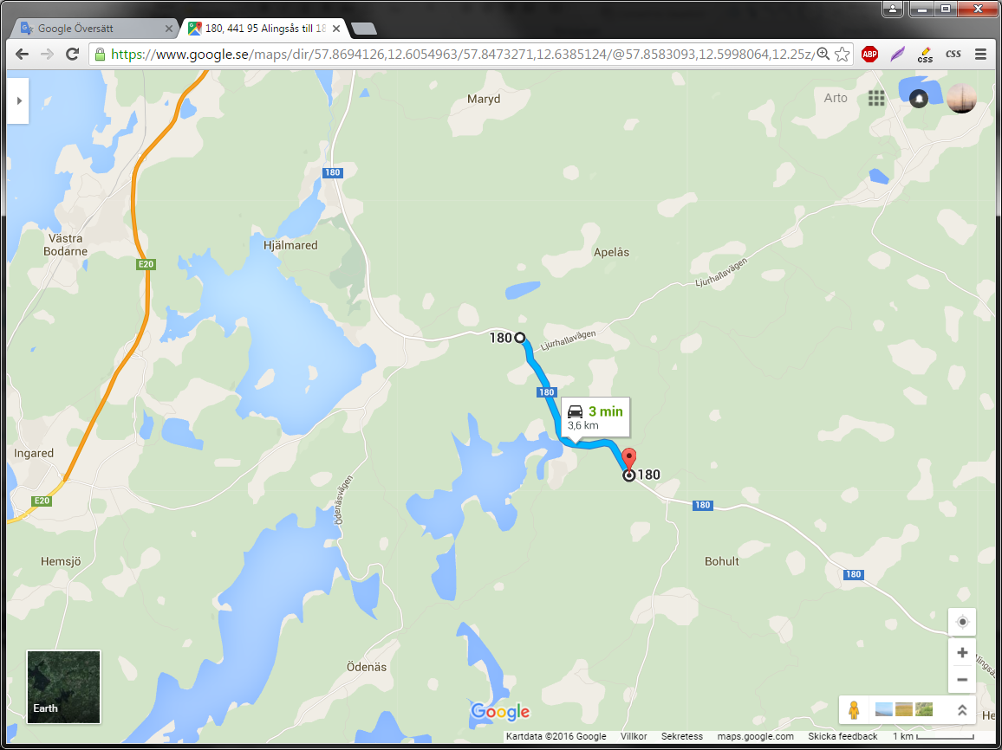
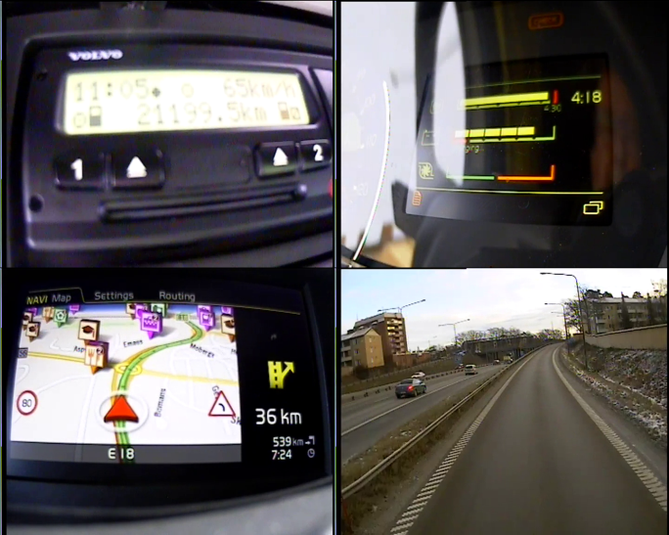



DATA REFINER Test leader Johan J
View
OVERVIEW
FH-1407 / MEA_0415 / 01 2016-01-14 23:15:05 – 2016-01-14 23:15:35
VIEW
ALL
VIEW
V 1
V 2
V 3
V 4
LOGS
CANalyzer
Protus ID ...
INCLUDE:
Comment ...
AUDIO
If protus id is entered, the log will be uploaded to central server and be attached as a link in protus report automatically.
If you don’t enter protus id the log is saved and stored on local server for later use.
VIDEO [CAM 1]
VIDEO [CAM 2]
SETTINGS
VIDEO [CAM 3]
NO VOICE
NAVI
ADD TAG
VIDEO [CAM 4]
2X2 GRID INCL AUD
DISCARD
Sorting category...
SAVE
HELP & INFO

Slide 17
DATA REFINER Test leader Johan J
LOGS / FH-1407 SEM w1607
OVERVIEW
Unhandled events
MEA_0415 / 01 2016-01-14 23:15:05 – 2016-01-14 23:15:35 1
MEA_0415 / 02 2016-01-14 23:16:15 – 2016-01-14 23:16:45 1
VIEW
MEA_0416 / 01 2016-01-14 23:30:10 – 2016-01-14 23:30:40
Radio
MEA_0415 / 01 2016-01-14 23:15:05 – 2016-01-14 23:15:35 4 [L561612] [STATUS 21] [5p]
LOGS
MEA_0415 / 02 2016-01-14 23:16:15 – 2016-01-14 23:16:45 4
MEA_0416 / 01 2016-01-14 23:30:10 – 2016-01-14 23:30:40
Launcher Crash
MEA_0415 / 01 2016-01-14 23:15:05 – 2016-01-14 23:15:35 1 [L234556] [STATUS 21] [25p]
MEA_0415 / 02 2016-01-14 23:16:15 – 2016-01-14 23:16:45 1 [L234556] [STATUS 21] [25p]
MEA_0416 / 01 2016-01-15 23:30:10 – 2016-01-14 23:30:40
MEA_0416 / 02 2016-01-15 14:15:05 – 2016-01-14 14:15:35
MEA_0416 / 03 2016-01-15 23:16:15 – 2016-01-14 23:16:45
MEA_1416 / 01 2016-02-01 15:30:10 – 2016-01-14 15:30:40 2
I-SEE / No pre-speed
SELECTED EVENTS:
SETTINGS
ON MAP
CONNECT TO PROTUS
ON TIMELINE
STATS
HELP & INFO
CENTRAL SERVER LOCAL SERVER OWN HDD

Slide 18

Conclusion
The current tools have enabled a tremendous saving for the Volvo Group (refering to the Volvo Group Quality Award 2014)
Enormous amounts of data have passed these tools and they are falling apart due to increased loads
Next generation of tools would enable
Efficiency – 85% reduction of workload
New creative ways of working
Trust, reliability and traceability

Slide 19
Back-up slides

Slide 20
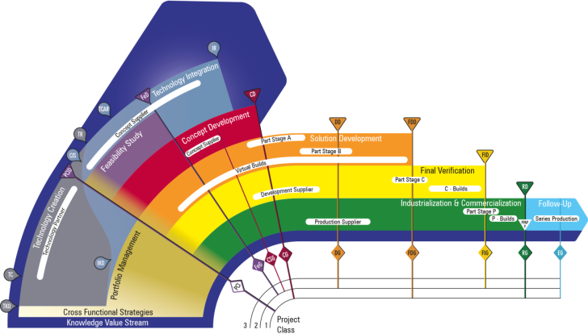
PVT Activities Tool Box
Discussions, Functional Walk Throughs, Sprint reviews
Requirement reviews together with Functional Owners
Clinics (Usability study)
PVT Development with simulations in rig and truck
Reviews of FRSs by Functional Walk Throughs, Driver Involvement in PD,
Clinics (Usability study)
PVT Check
PVT Base
PVT Total
PVT EU/US/SA/Asia
Protus Verification
Discussions using experience from previous PVT testing, PROTUS status 7, ER recommendations etc
Competitor Benchmark
Concept Evaluations
TRL evaluations
Clinics (Usability study)

Slide 21

Next Step
To be added
...
Test cases
Step 1 Work in current tool
Update all test cases
Step 2 New tool with current data
Step 3 New tool with automated way of working

Slide 22
PVT Step 1.5 (Short-Term Mid 2016)
Test Case Structure
Methods for PVT Development Test Cases
Stable EFACTS + better video support (Maintenance)
Stable Collector + Manager
PVT Manual
ER/Test Reports
Define the need & requirements for PVT Step 2
PVT Step 2 (Long-Term IT-Dependent)
New EFACTS
New Manager
New Collector
Change M-Logger to P blue piraT?

Slide 23
Background material/brain storm minutes

Slide 24
Current tools status
Prototype tools, created from blank paper with a lot of added functionality
Collector and Refiner unreliable,
Problems start with MLOG
When too many files are taken
When too big files (increased video) are taken
Different formats of logfiles if loaded manually or automatically (offline mode would solve this issue)
Sensitive to exact data available, if something is missing the system crashes. E.g. Impossible to check in a log file without a video file if there should be a video (but the video file was accidentily missed during the test)
In education material for E-FACTS there are many ”don’t”s (!) – the tools should not allow actions that create a mess
Instead of warning the user, the system crashes today, the system is very unstable. A small mistake can cause a crash. Users have a feeling of distrubing the system by the smallest mistake. Point of no return.
Not user friendly in many ways
Test Engineers work outside/around the tools since they can not be trusted
Development has been standing still several years
The tools needs adaptations to projects (P2967 needs new ways of working)
No support for multiple video
No trace of logfiles connected to a test engineer (small mistakes cause many hours of work )
Many files get lost
When crashed, very hard to find log files (lost in database)
Resources have not been granted
Now we can use the prototype tools and create a stable solution

Slide 25
What is needed
Stable tools that can be trusted
Traceability of what has been done by one user (e.g. See what log files that I have checked in in several vehicles or projects and also what reports that have been written).
E.g. Protus status 21 – wrong log file connected => need to find the correct log file and add that to the protus
Overview - Create, edit, delete, search (what log files have been connected to PROTUS)
Protus verification – the old log file connected to the fault shall be easily accessed to compare
Involve in next test with ”one click”’
Load several MEAs at the same time
Tag many log files at the same time (sort several log files with filters, e.g. No radio reception )
Possibility to search and overview tags (and to create new/unique tags needed for a project)
Possibility to work with a checked-in logfile (add new tags, use in new report, listen again etc)
Use one logfile in several reports
Video and audio connected when available
Reports connected to projects to compare SW issues (in addition to vehicle & baseline comparison) and projects
What tests were run in the project
How much was ”found” in each test during the project => use as white book
Have everything in this tool (avoid Excel)
Independent of wifi – offline mode available (sync automatically when wifi available)
Easy accessible and user friendly
Same tool for the whole PVT process (create test, everything is connected)
MLOG update
Adaption to new techniques
Watch CAN signals in separate e.g. iPad or phone via WIFI
Handle large amount of data with many video signals and long log files

Slide 26
Why is a new tool needed
Work flow Efficiency
Show where Excel should be avoided and what is not working today, will be a good support for understanding, traceability, time spent measurement
Add new tests, e.g. PVT City, PVT North America, PVT Japan...
PVT Development – new way of working, choose a number of test cases, run them, add new, delete, create new...
Increase test quality
Test engineer control through the test process, test process overview and progress easily followed
Good tool for the testing improves efficency, creativity and test quality ingeneral
Increase product quality
Protus reports are sometimes closed since the log file cannot be found
Avoid frustration (creates inefficiency)
The current tools are very good when they work but when something fails, it creates a lot of frustration and more workload
The possibilities are fantastic but increased stability, usability and structure are needed
Current tools seems to make the user adapt to the tools, not the other way (adapt to the tool capabilities, not make the tools do the needed work)
Ideas of improvement have not been possible to implement due to current code structure

Slide 27
What can be achieved
Improved quality of tests
Better information => improved PROTUS => improved understanding
=> Improved product
Efficiency! Decreased Leadtime the whole way from a fault is found to when the fault is solved
Traceability – red thread through the tool chain
For a user
In between users
For a fault
For a test case/Truck Function

Slide 28
Test Cases structure
Simplify the texts to make them faster to read when performing the tests
”Columns” (Example in Visio of Seat Belt Reminder & Cruise Control)
Truck Function Area
Truck Function
Test Title/Suite/Header/Area (as generic as possible for all product classes)
Requirement connection
Test Case Description (to enable validation, product class and variant dependent)
Test Case Expected Result/Additional information (product class and variant dependent)
OK/NOK/Blocked/NA
Comment/Driver
Variant string
Test preconditions (e.g. Hilly, Trailer, Standstill...t be sorted on)

Slide 29
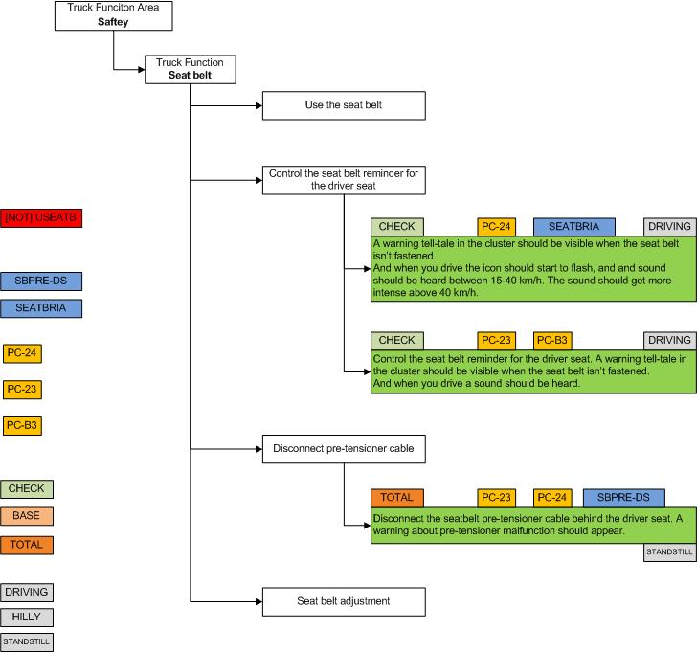
Proposal
Drag-and-drop product classes and other tags

Slide 30
Conclusion
The current tools have enabled a tremendous saving for the Volvo Group (refering to the Volvo Group Quality Award 2014)
Enormous amounts of data have passed these tools and they are falling apart due to increased loads
Next generation of tools would enable
Efficiency (can be measured in kilo man hours)
New creative ways of working
Trust, reliability and traceability

Slide 31
Next Step
Connect test cases and log files

Slide 32
PVT Manager
Test Cases
Test Sequences
Test Routines
Test Procedures

